Slide 1

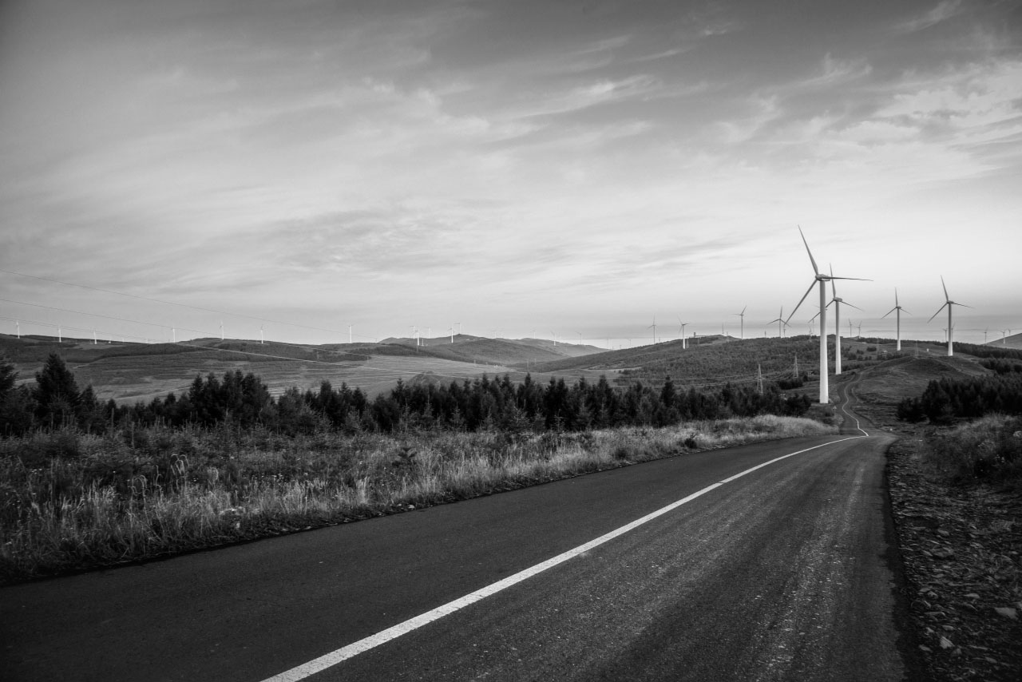
Jingsheng Zhang
How much percentage does COVID-19 change the attitude of Twitter users towards Wuhan using sentiment analysis?

Slide 2
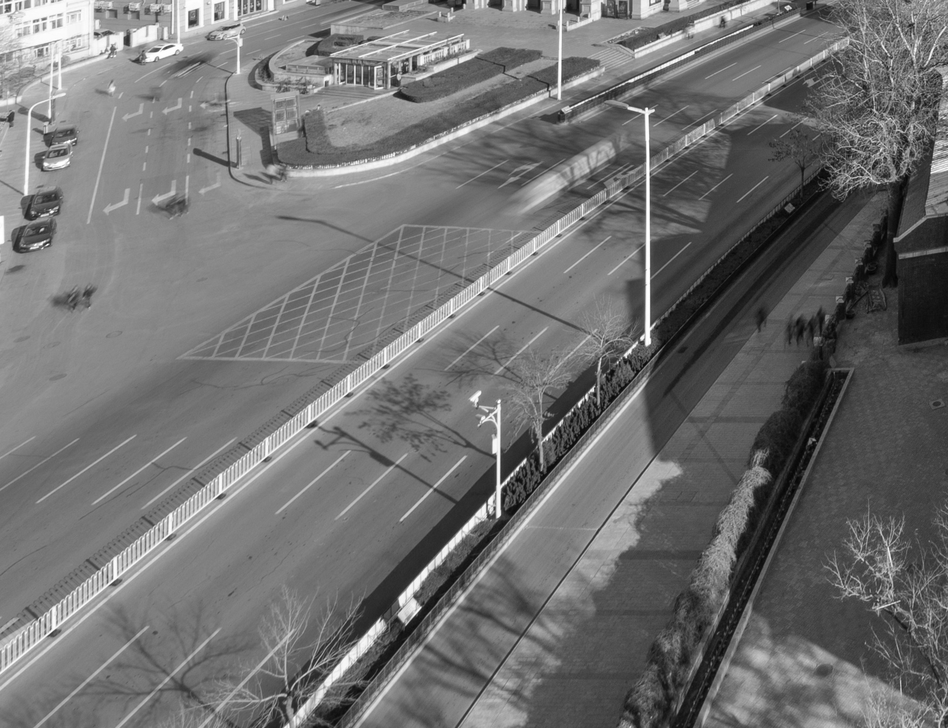
CONTENTS
01
Motivation
02
Literature Review
03
Theory Section And Testable Hypothesis
04
Dataset and Methods
04
Result and Conclusion

Slide 3

Section Header Here
/01
Supporting text here.
When you copy & paste, choose "keep text only" option.
01
Motivation

Slide 4

Wuhan is a hero city!
There is an idiom in Chinese called preconceived ideas, which means that what you hear first or the first impression you get is often dominant in your mind. When you encounter different opinions later, it is not easy to accept.

Slide 5




It is challenging
Just like this COVID-19 virus, when people heard that the outbreak originated in Wuhan, people also preconceived that it was a virus brought by Wuhan. Although the follow-up WTO expert group also confirmed that this did not spread from Wuhan to the world, this is also excusable. In such a situation, people will involuntarily install COVID-19 in Wuhan from the subconscious. Therefore, it is also significant to study the changes in people's perception of Wuhan over time before and after COVID-19.

Slide 6
Section Header Here
/01
Supporting text here.
When you copy & paste, choose "keep text only" option.
02
Literature Review

Slide 7

During the pandemic, people use social media a lot more than before and express their true feelings. Unlike traditional media, on social media, multiple organizations can disclose different sentiments at the same event; and readers can quickly respond to these tweets. After examining the tweets posted by nine authoritative public organizations in four countries and the World Health Organization from December 1, 2019, to May 10, 2020, using the Inverse Probability Weighting model, Yu et al. (2022) found that Topics with negative sentiment polarity on COVID-19 attracted more replies (69±49) and favorites (688±677) than positive tweets. Although there was no significant difference in the number of retweets between negative and positive tweets.
Impact on
social media

Slide 8
Focus on Tweets
Furthermore, considering the tweets all over the world(Lwin et al., 2020), using “wuhan,” “corona,” “nCov,” and “covid” as search keywords from January 28 to April 9, 2020, the total number of 20,325,929 tweets and over 170 countries were collected.
Tweets focused on four emotions: fear, anger, sadness, and joy which are the basic emotion pairs of opposite experiences. From generating the percentages of these four emotions and making a time-series plot, they found that fear was the dominant emotion at the end of January when the disease first surfaced which probably related to the emergency of COVID-19 and its unknown nature. The percentages changed over time and as time goes on, the percentage of fear decreased, and the percentage of joy increased.

Slide 9

Research Need
To Be Done
It is not difficult to see that people still have certain complaints about COVID-19. This is not only very important for the humanistic research of COVID-19, but in a sense, it is also very important for the research on the psychological changes of the masses to public events within the scope of psychology.

Slide 10
Section Header Here
/01
Supporting text here.
When you copy & paste, choose "keep text only" option.
03
Theory Section And
Testable Hypothesis

Slide 11

Variables
In this research, the independent variable will be time, which varies from 6 months before COVID-19 first breaks out in Wuhan and 24 months after COVID-19 first breaks out in Wuhan on a monthly basis. The dependent variable will be the attitude of Twitter users to Wuhan behind tweets using sentiment analysis and topic modeling to get the percentage of positive and negative attitudes.

Slide 12
Hypothesis
One potential counterargument might be that the percentage of positive and negative attitudes changed when COVID-19 first broke out and didn’t change much after COVID-19 broke out until now. The null hypothesis is: There is less than a 30 percent change in attitudes of Twitter users toward Wuhan after the COVID-19 pandemic. The alternative hypothesis: There is more than a 30 percent change in attitudes of Twitter users toward Wuhan after the COVID-19 pandemic.

Slide 13

From an objective point of view, before the outbreak of COVID-19, people's attitude towards Wuhan should be more positive, or 50-50. Until the start of COVID-19, the public's attitude towards Wuhan should begin to gradually turn negative. as s trend may continue to climb until it peaks in the United States with the outbreak of the pandemic. At the peak, it may last for a period, three months, or even six months, and then slowly decline as the vaccine is produced and promoted and the epidemic is controlled.
Theory

Slide 14
Section Header Here
/01
Supporting text here.
When you copy & paste, choose "keep text only" option.
04
Dataset and Methods

Slide 15

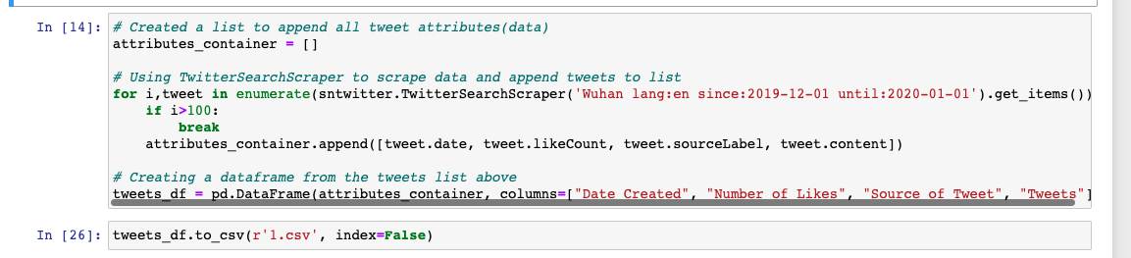
Dataset

YOUR TITLE
All the datasets are collected from Tweeter using snscrape from python to scrape tweets.

YOUR TITLE

YOUR TITLE

Slide 16

Methods
Use R to do the pre-processing and modeling. Tackle the question by using lemmatization, stemming, removal of stop words, and omissions.
Use the Bing lexicon to do sentiment analysis and the get_sentiments function from the package “tidytext”. And then do the visualization or show the table of the top 10 sentiment and calculate the percentage of positive or negative sentiments.

Slide 17
Section Header Here
/01
Supporting text here.
When you copy & paste, choose "keep text only" option.
05
Results and Conclutions

Slide 18
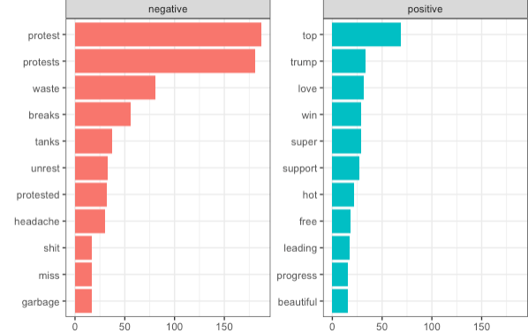
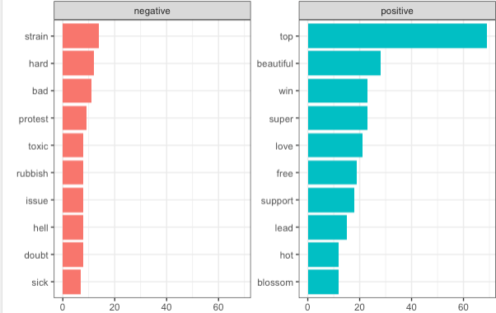
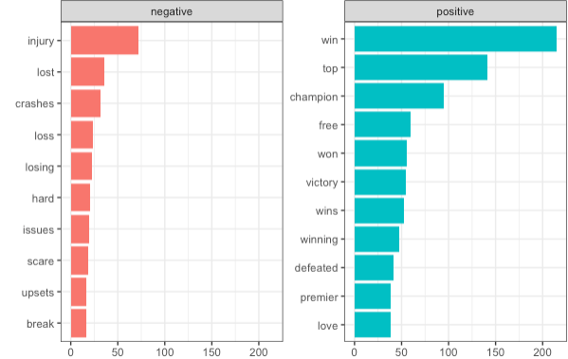
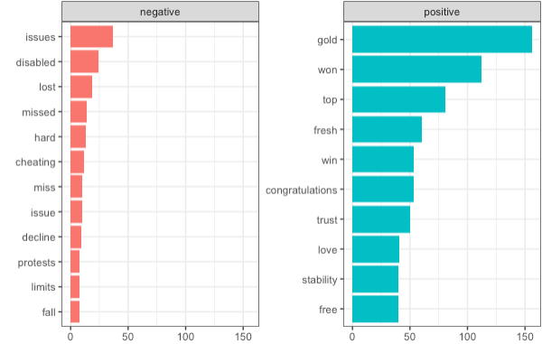
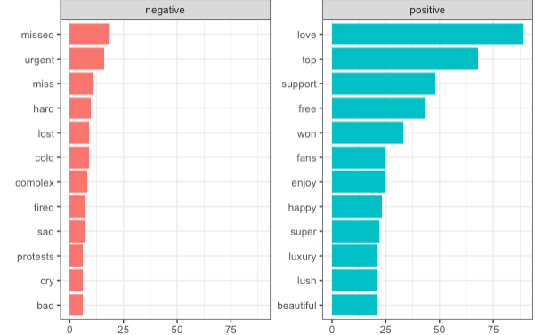
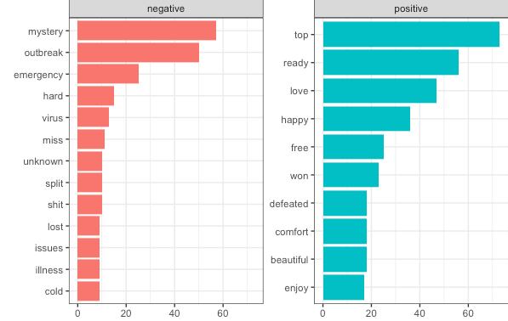
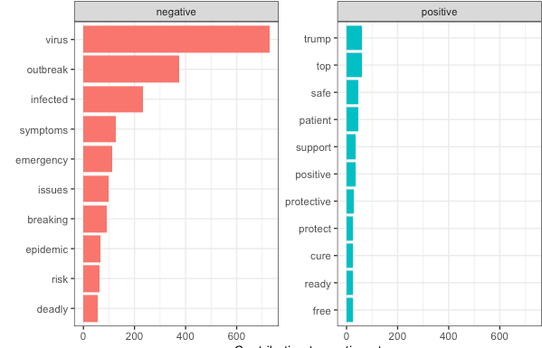
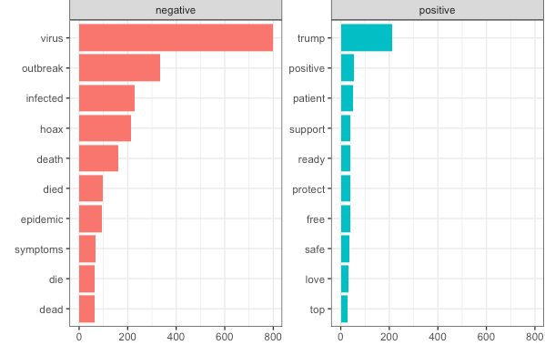
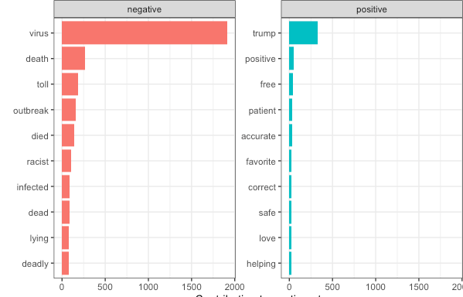

Slide 19
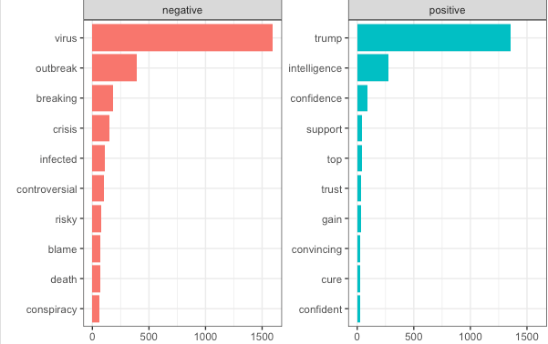
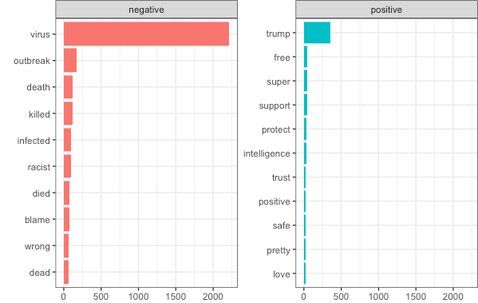
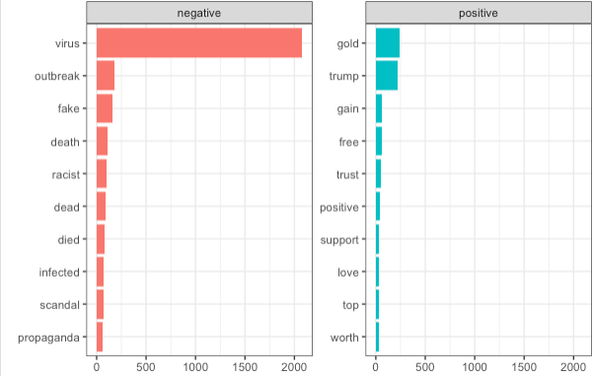
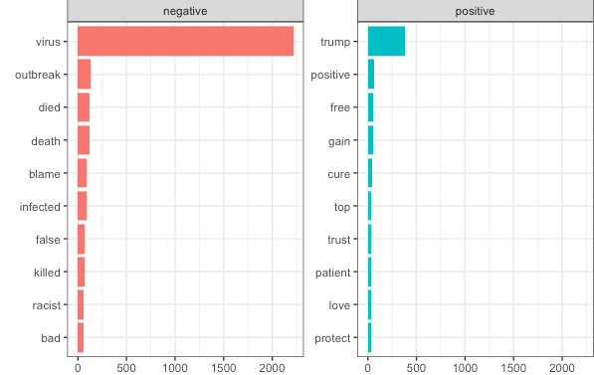
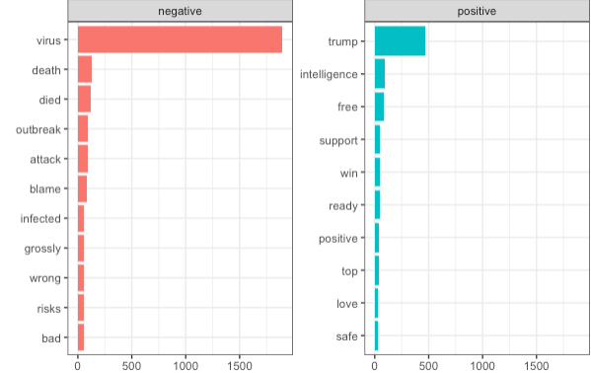
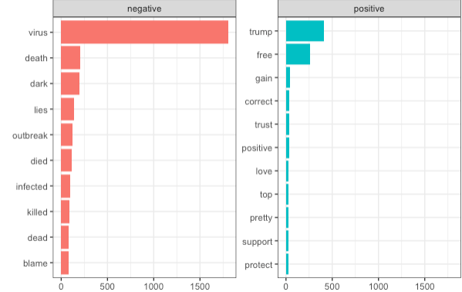
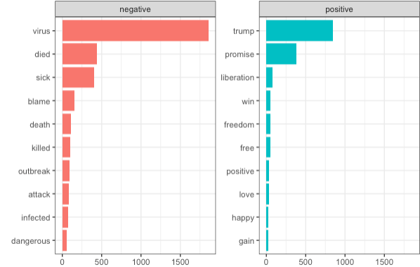
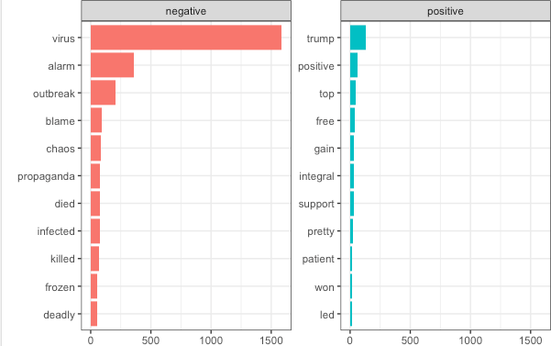
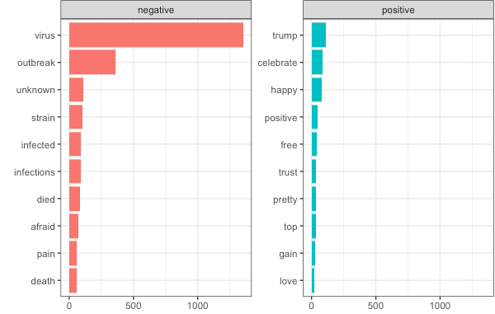

Slide 20
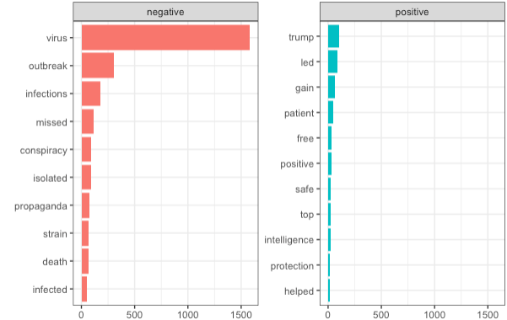
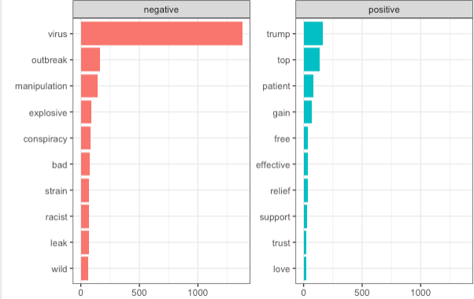
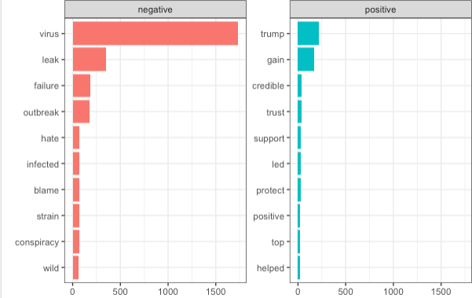
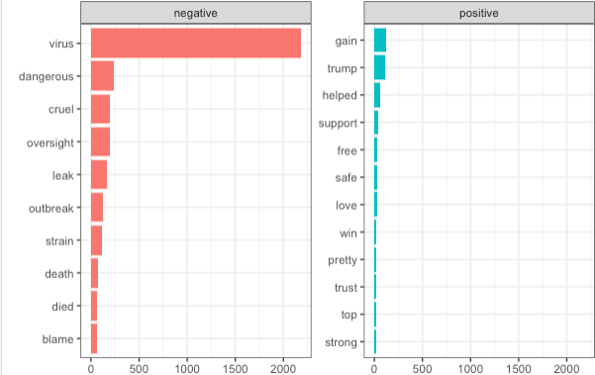
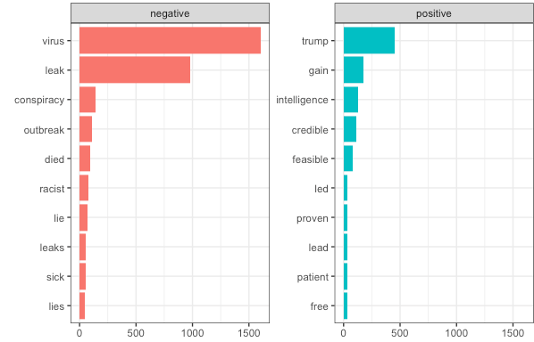
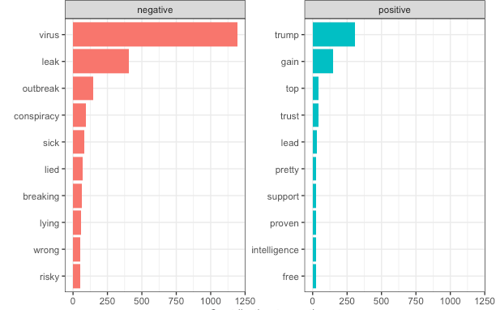
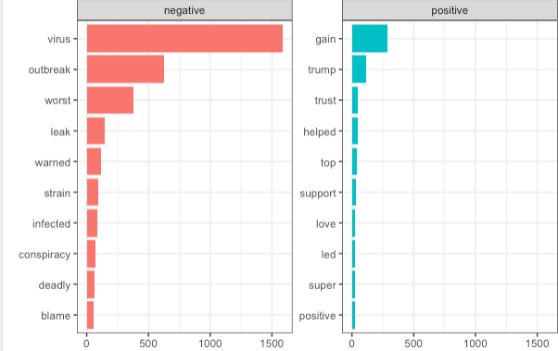
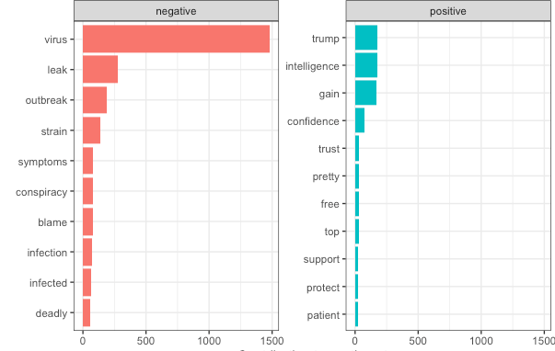
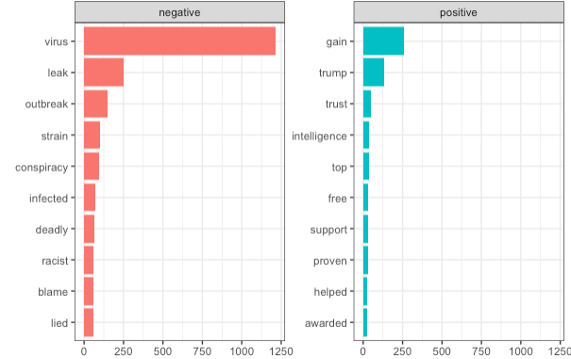

Slide 21
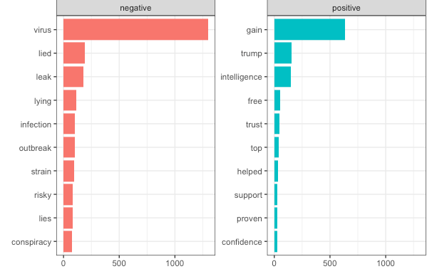
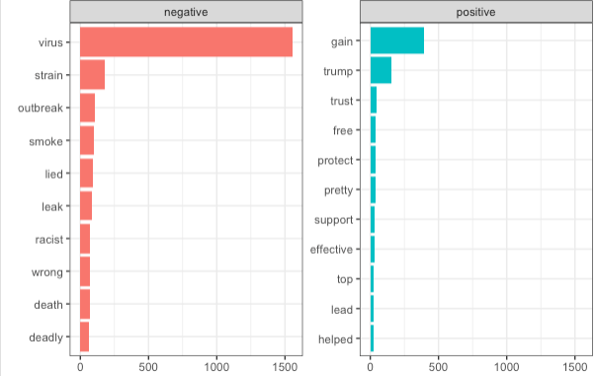
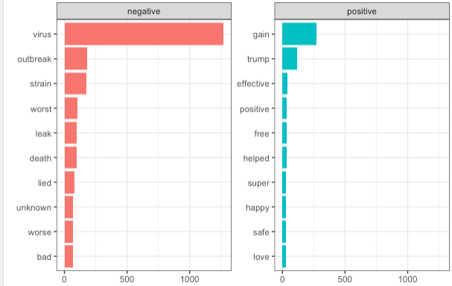

Slide 22





From all the 30 plots, we can see that the positive attitude percentage is as high as 90% before the COVID-19 and it dropped quickly to as low as 10% within the first several month. And it remains nearly 0.2 for the whole two years in after the COVID first break out in Wuhan.
Conclusions

Slide 23
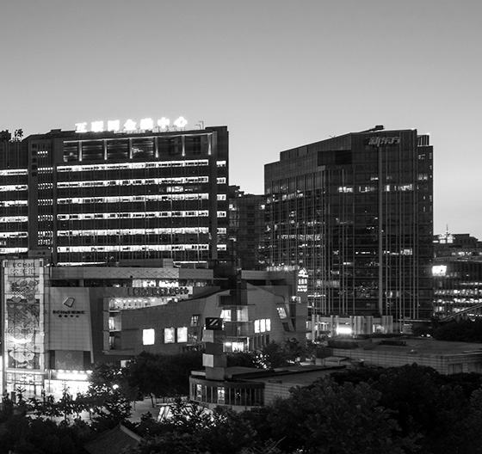

Dataset is 5000 tweets per month, this is limited by the PC, could be much more in the future.
Could eliminate “trump”for the positive words as it showed up for nearly all of them.
Limitations

Slide 24
Thanks
Jingsheng Zhang

